Slide 1
Programming Basics
Vivify Academy

Slide 2
Decision Making and Control Flow

Slide 3
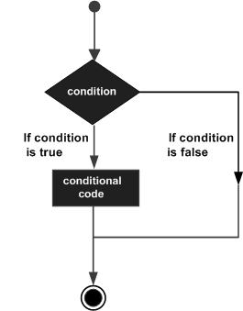
Control flow statements are used to take decision based on some condition. Javascript supports the following three decision making statements:
if statement
else statement
switch statement (won’t be covered now)

Slide 4
What’s a “condition”?
In programming languages, a condition is any expression that can be evaluated as true or false. In most cases these expressions are boolean values, but in Javascript they can be any type of value. A condition is said to be “true” if its value can be converted to the boolean true. Examples would be:
a boolean true,
some number other than zero,
a non-empty string, etc.

Slide 5
The if statement
Use this statement if you want to execute a piece of code only when some condition is true.

Slide 6
Pseudocode
Javascript
if (condition) code to be executed if condition is true;
// this gives us a number of the week of the current day:
var today = new Date().getDay(); if (today === 5) { // Friday console.log("Finally!"); }

Slide 7
What is pseudocode?
Alternatively referred to as p-code, pseudocode is a simplified programming language that resembles plain English, that cannot be compiled or executed, but explains a resolution to a problem.

Slide 8
The if - else statement
Use this statement if you want to execute a set of code when a condition is true and another if the condition is not true. You can’t use else without if.

Slide 9
Pseudocode
Javascript
if (condition) code to be executed if condition is true;
else code to be executed if condition is false;
// this gives us a number of the week of the current day:
var today = new Date().getDay(); if (today === 5) { // Friday console.log("Have a nice weekend!"); } else { console.log("Have a nice day!");
}

Slide 10
The else if statement
The else if statement is used with the if - else statement to execute a set of code if one of the several condition is true.

Slide 11
Pseudocode
Javascript
if (condition) code to be executed if condition is true;
else if (condition) code to be executed if condition is true;
else code to be executed if condition is false;
// this gives us a number of the week of the current day:
var today = new Date().getDay(); if (today === 5) { // Friday console.log("Have a nice weekend!"); } else if (today === 0) { console.log("Have a nice Sunday!");
} else { console.log("Have a nice day!");
}

Slide 12
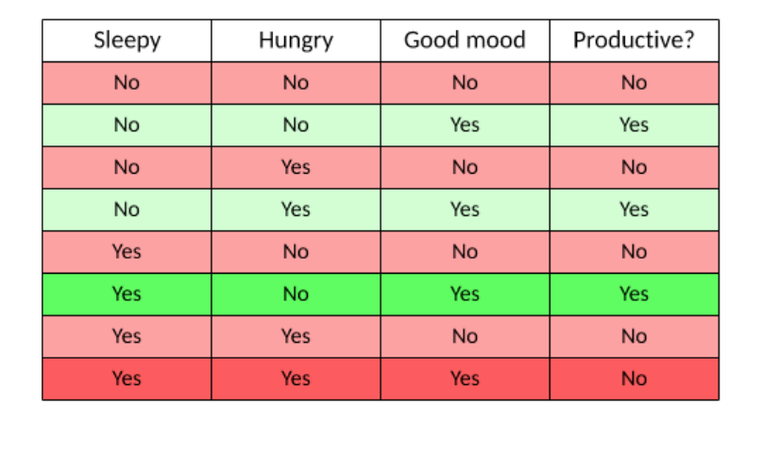
Exercise

Slide 13
Loops

Slide 14
What is a loop?
A loop is code that describes repetition of the same instructions or processes, over and over until receiving the order to stop. This allows us to do the same operation many times over, without knowing in advance how many times it needs to be repeated.
However, if not handled properly, an endless loop can cause the computer to get “stuck” as it becomes overwhelmed with unending operations. In Javascript this means the page becomes unresponsive, and the browser may prompt the user to end the execution by for ce.

Slide 15
Loops in Javascript
Loops are used to execute the same block of code a specified number of times. This block of code is called the body of the loop. Some loop types that Javascript supports are:
while − loops through a block of code if, and as long as, a specified condition is true
for − similar but differently structured, usually used to go over a range of numbers
for-of − executes a block of code for each element in an array (will be covered tomorrow)
We will also discuss about continue and break keywords which can be used to make exceptions to the normal loop execution flow.

Slide 16
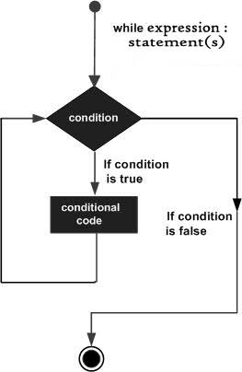
The while loop statement
The while statement will execute a block of code if, and as long as a test expression is true. If the test expression is true then the code block will be executed. After the code has executed, the test expression will be evaluated again and the loop will continue until the test expression is found to be false.

Slide 17
Pseudocode
Javascript
while (condition) { code to be executed; }
var i = 0;
// as long as i is less than 10... while (i < 10) {
// increase i by 1 i++; } console.log('Loop stopped, current value of variable i is:', i);

Slide 18
Infinite loops
Whenever we use a loop, we must make sure that it will eventually terminate. That means that there must be a way for the condition to change from true to false at some point. If we comment out i++ in the below code, the program will never end by itself and we’ll have to “kill” the page script.
var i = 0;
while (i < 10) {
i++;
}

Slide 19
Possible mistakes
In loop statements, we don’t put a semicolon after the condition in parentheses. This is not valid syntax:
var i = 0;
while (i < 10;) {
console.log(i++);
}

Slide 20
Possible mistakes
This is syntactically correct, but doesn’t produce the desired behavior, instead it enters an infinite loop:
var i = 0;
while (i < 10); {
console.log(i++);
}

Slide 21
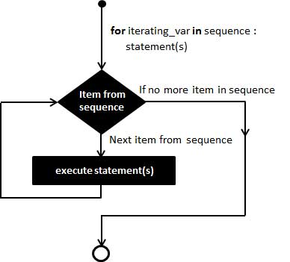
The for loop statement
The for statement is used when you know how many times you want to execute a statement or a block of statements. Any for loop can be written as while and vice-versa, but the for loop is more convenient for iterating over a range of numbers.

Slide 22
Pseudocode
Javascript
for (initialization; condition; step) { code to be executed; }
console.log('Printing numbers 1 to 10:'); for (var i = 1; i <= 10; i++) { console.log(i); } console.log('Loop stopped, current value of variable i is:', i);

Slide 23
Equivalence of for and while
while
for
while
for (var i = 0; i < 5; i++) { // do something...
}
var i = 0;
while (i < 5) {
// do something...
i++;
}

Slide 24
Nested loops
Loops can be nested, meaning you can have one loop inside another.
for (var i = 0; i <= 5; i++) {
for (var j = 0; j <= 5; j++) {
console.log(i, '*', j, '=', i * j);
}
}

Slide 25
Special statements in loops

Slide 26
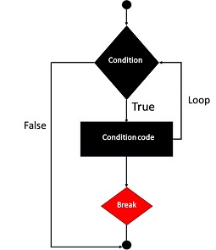
The break statement
The Javascript break keyword is used to terminate the execution of a loop prematurely. The break statement is placed inside the statement block, and if encountered the program flow jumps out of the loop. It allows you to exit from the loop even when the loop condition is still true, which is useful for exceptional cases.

Slide 27
The break statement - example
// print the first number divisible by 25 between 30 and 100
for (var i = 30; i <= 100; i++) {
if (i % 25 === 0) { // is i divisible by 25
console.log(i);
break;
}
}

Slide 28
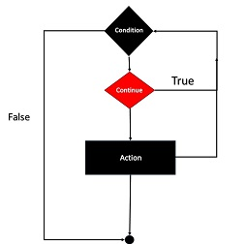
The continue statement
The continue keyword is used to stop the current iteration of a loop and jump immediately to the next one, but it does not terminate the entire loop. Just like the break statement, the continue statement is placed inside the statement block containing the code that the loop executes. When the program flow encounters the continue statement, the rest of the code in the loop body is skipped and the next pass starts.

Slide 29
The continue statement - example
// print the first *odd* number divisible by 25 between 30 and 100
for (var i = 30; i <= 100; i++) {
if (i % 2 === 0) {
continue;
}
if (i % 25 === 0) {
console.log(i);
}
}

Slide 30
If statement cheat sheet
if (condition) {
// code to be executed if condition is true
} else if (anotherCondition) {
// code to be executed if condition is false and anotherCondition is true
} else {
// code to be executed if none of the conditions are true
}

Slide 31
Loops cheat sheet
while (condition) {
// code to be executed as long as the condition is true
}
for (initialization; condition; step) {
// code to be executed as long as the condition is true
}

Slide 32
Operators cheat sheet
Name | Operator | Usage example
increment | ++ | i++ or ++i
decrement | -- | i-- or --i
division remainder | % | i % 2
string concatenation | + | var str = 'Hello'; str = str + ' world';

Slide 33
Example - checking if a number is prime
A prime number is a number that’s not divisible by any other numbers other than 1 and itself. We can check if a number is prime by trying to divide it with all numbers between 1 and itself, and check that there’s no remainder in any case.

Slide 34
Solution
var n = 97;
var noDivisorsSoFar = true;
for (var divisor = 2; divisor < n; divisor++) {
if (n % divisor === 0) {
noDivisorsSoFar = false;
break;
}
}
if (noDivisorsSoFar) {
console.log('Number', n, 'is prime.');
} else {
console.log('Number', n, 'is not prime. It\'s divisible by', divisor);
}

